Slide 1


Data Science Programming
spotify-2023.csv
FINAL
PROJECT
Olivia O’Mahoney
07/17/2023

Slide 2
MY DATA SCIENCE PROJECT
For my final Data Science Programming Project, I needed to find a CSV file, explore it, clean it, and answer a few questions about it. I spent the course of a few months designing this project.
My project revolves around a csv file containing the top songs of 2023 along with different characteristics of each song such as its name, artists, bpm, key, streams, and many more.
This project will delve into the many different aspects and questions that arose reading this csv file!

Slide 3
CONTENTS
1
READING AND IMPORTING
2
EXPLORING
3
CLEANING
4
QUESTIONS

Slide 4
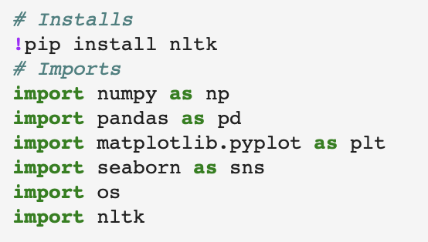
IMPORTING
The very first step in my project is to import needed python modules
The modules I imported are
numpy
pandas
matplotlib.pyplot
seaborn
os
nltk

Slide 5
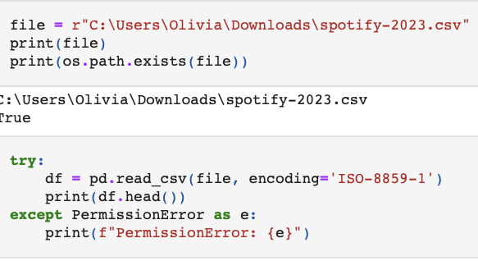
Reading
the
CSV
READING IN THE CSV

Slide 6
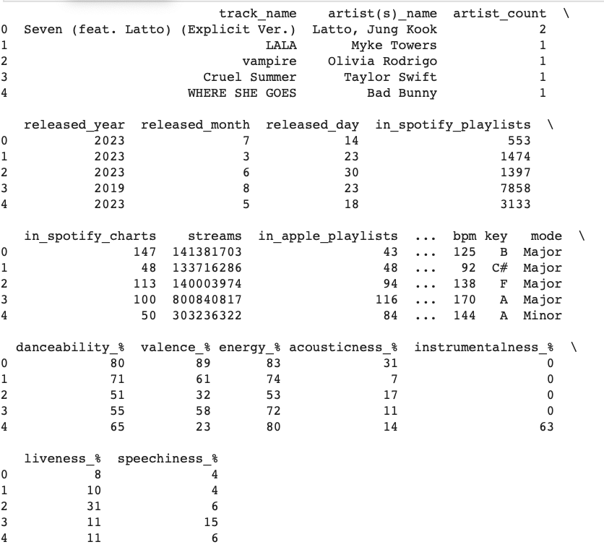
The
CSV
File
THE CSV

Slide 7
EXPLORING THE DATA
pandas
Types of Exploration
The python tool used to explore the data is
pandas
This tool uses many different function to explore many aspects of the data
pandas using many tools including:
df.head()
shows the first few rows
df.tail()
shows the last few rows
df.info()
shows basic information of the csv
df.sample()
samples a few rows in the dataset
df.columns()
show the names of all the columns
df.dtypes()
shows the types of data in each column
df.describe()
describe the csv

Slide 8
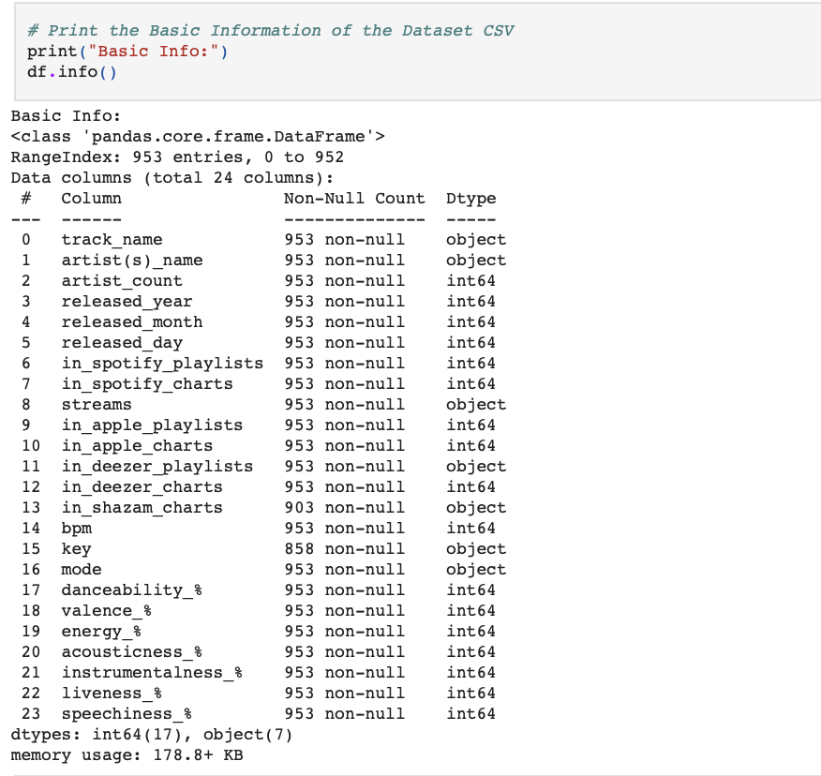
Basic Info

Slide 9
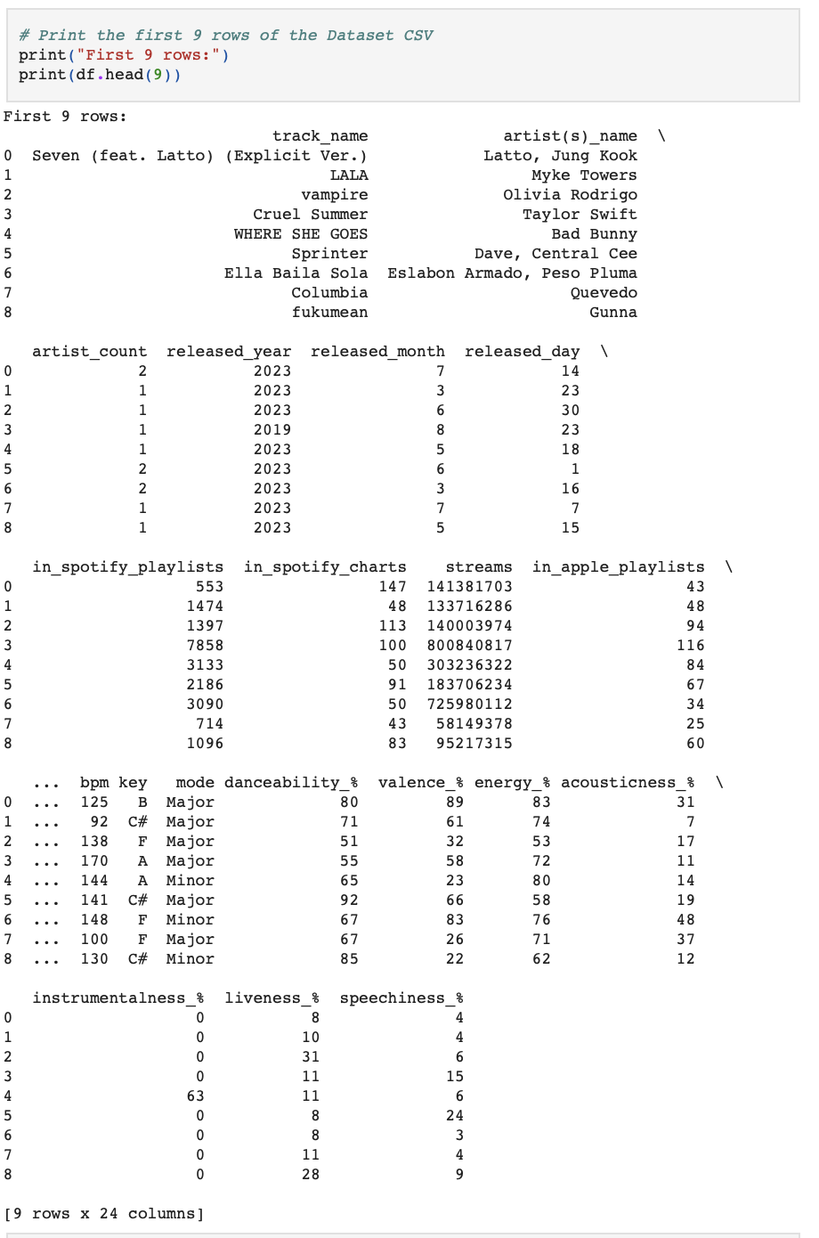
Head

Slide 10
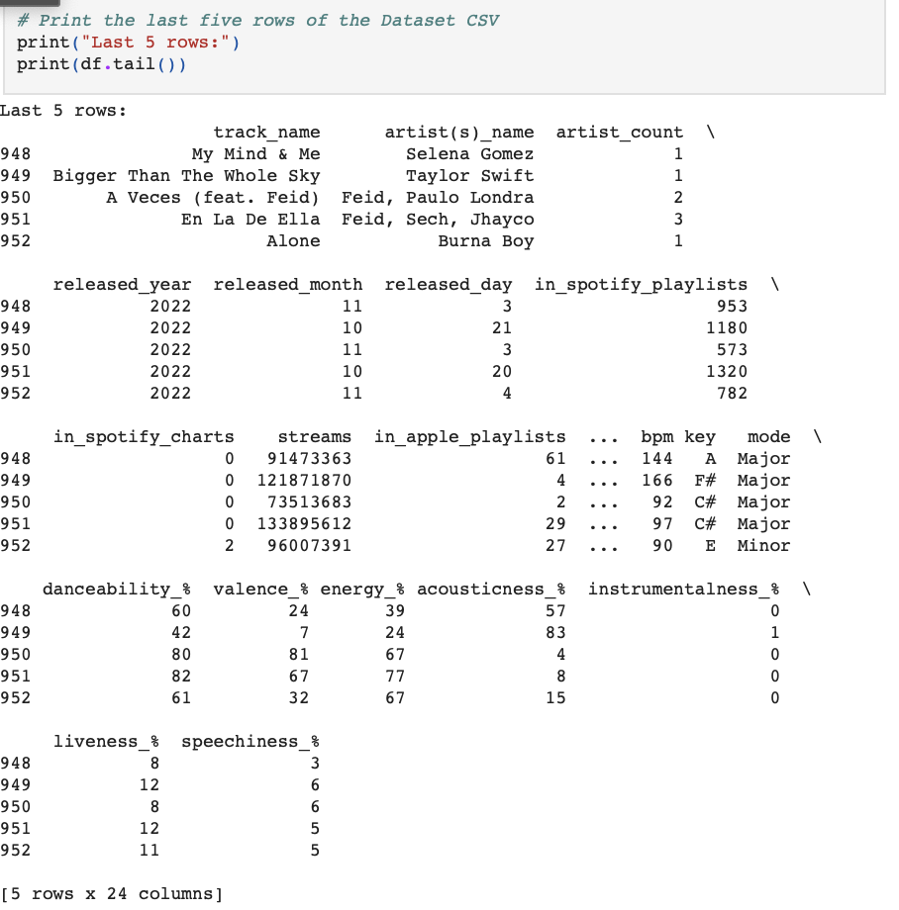
Tail

Slide 11
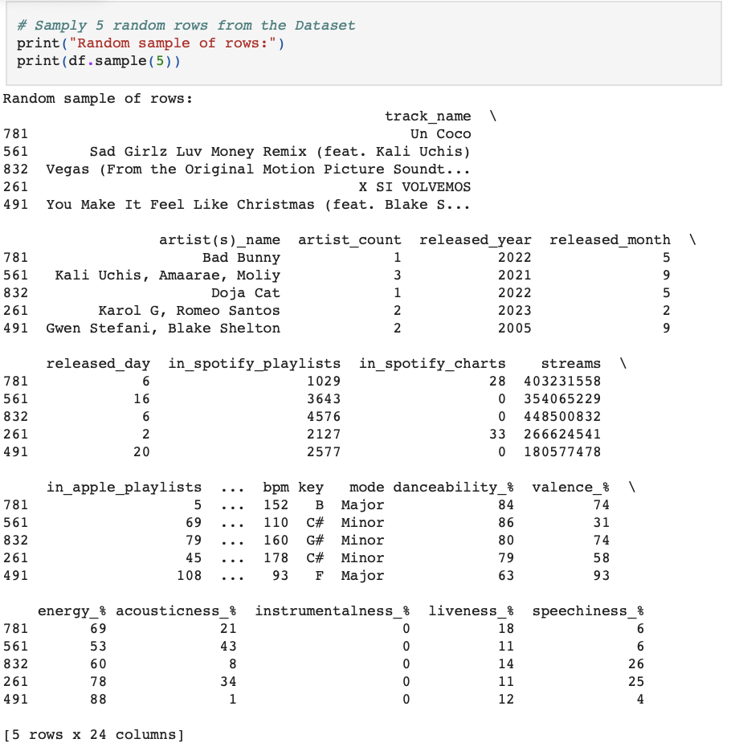
Sample

Slide 12
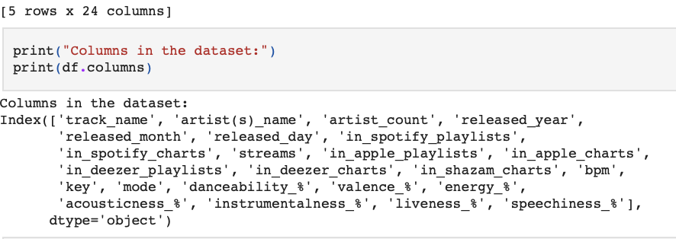
Columns

Slide 13
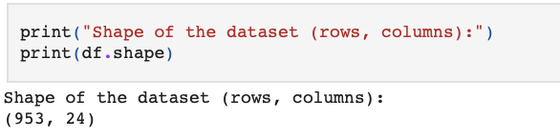
Shape

Slide 14
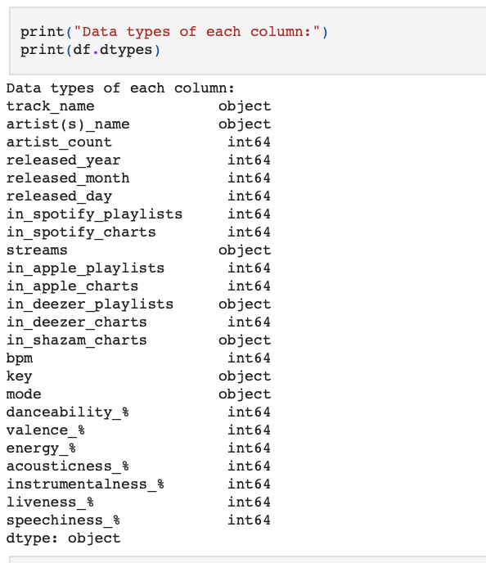
Dataframe Types

Slide 15
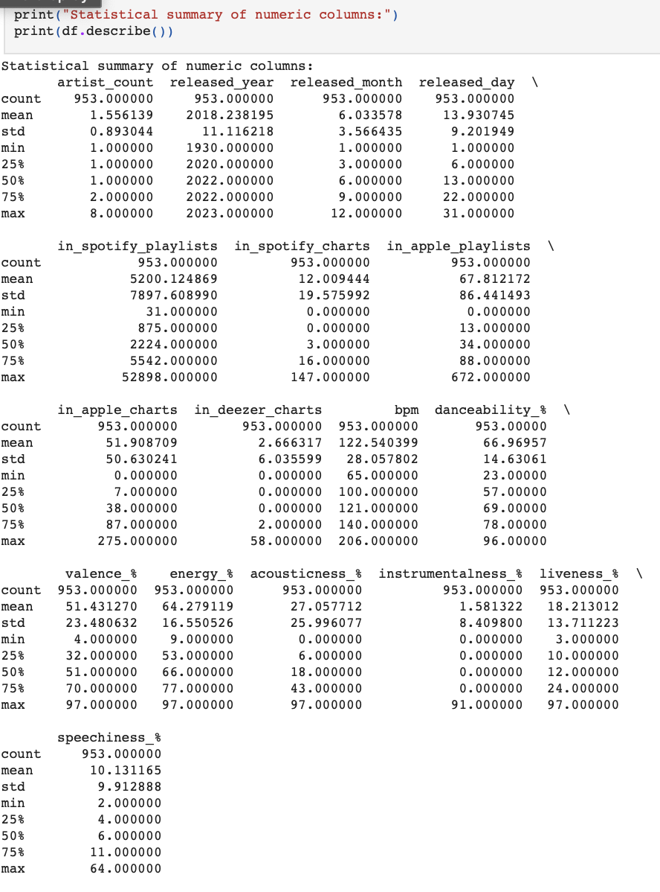
Describe

Slide 16
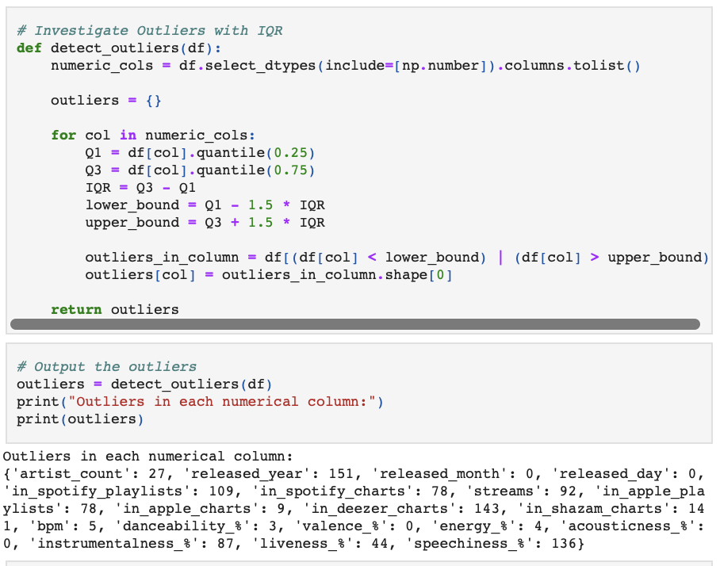
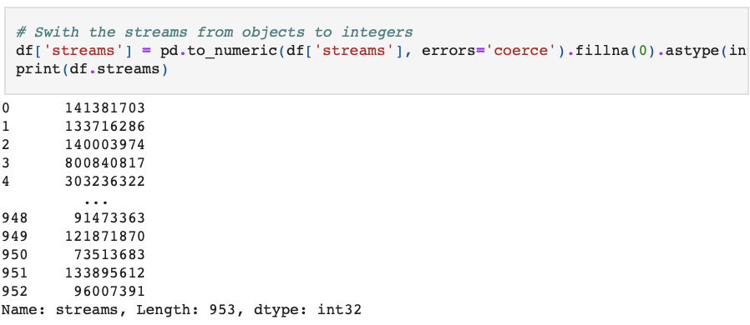
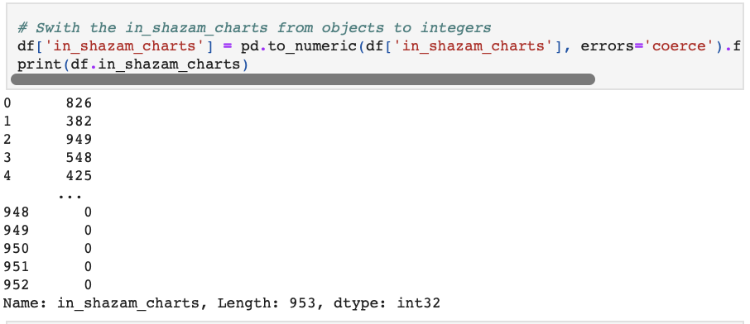

Many different ways I had cleaned the data such as outlier finding, NaN, and changing data types
CLEANING THE DATA

Slide 17
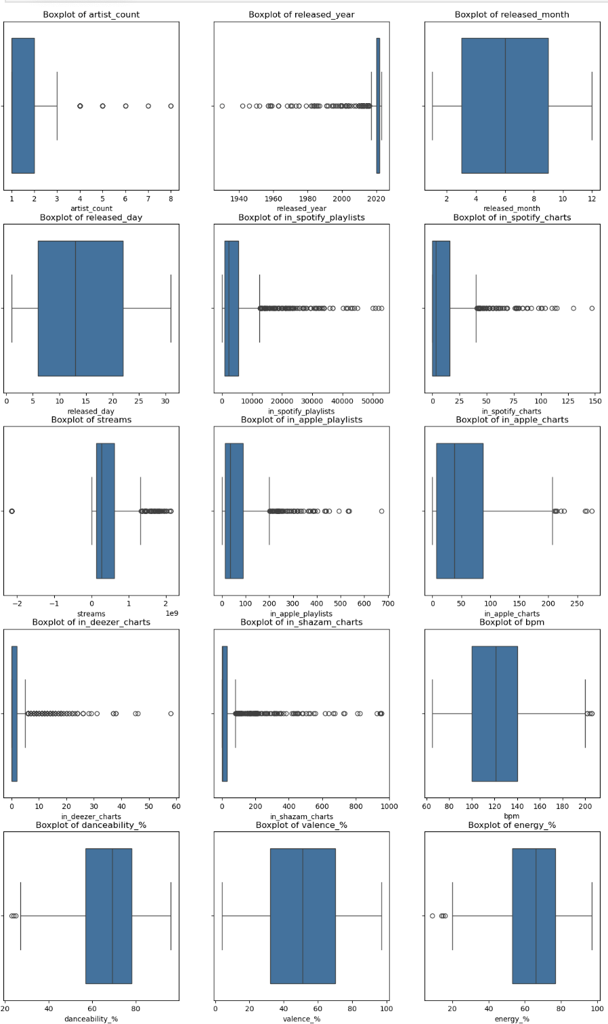
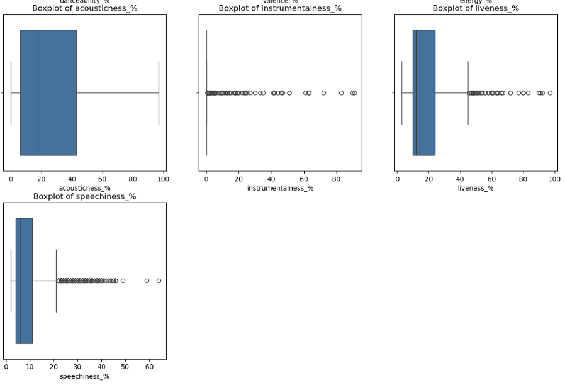
My BoxPlots
I created boxplots to the the representation of variable data

Slide 18
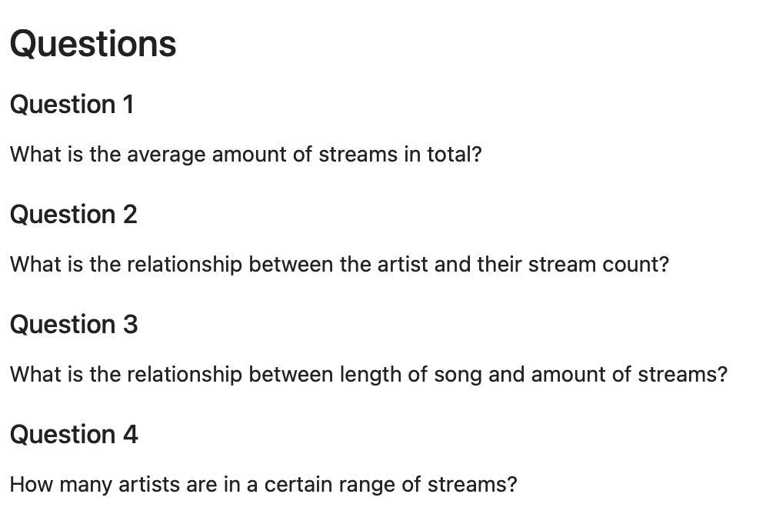
QUESTIONS
QUESTION 1
QUESTION 2
What is the average amount of streams in total?
What is the relationship between the danceability and energy?
QUESTION 3
QUESTION 4
What is the relationship between bpm and amount of streams?
How many artists are in a certain range of streams?

Slide 19
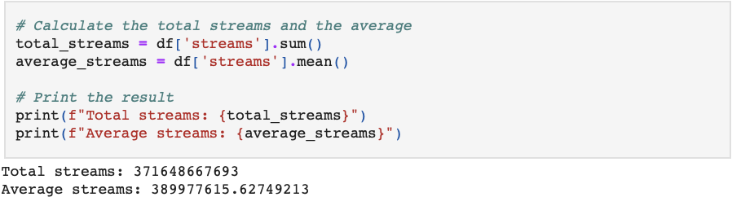
Question 1
What is the average amount of streams in total?
For this question, I used simple calculations to answer. I was curious what the total amount of streams combined throughout all of the songs was and the average number of streams. These answers would be relevant to streaming platforms and services such as Spotify where I got the data from.

Slide 20
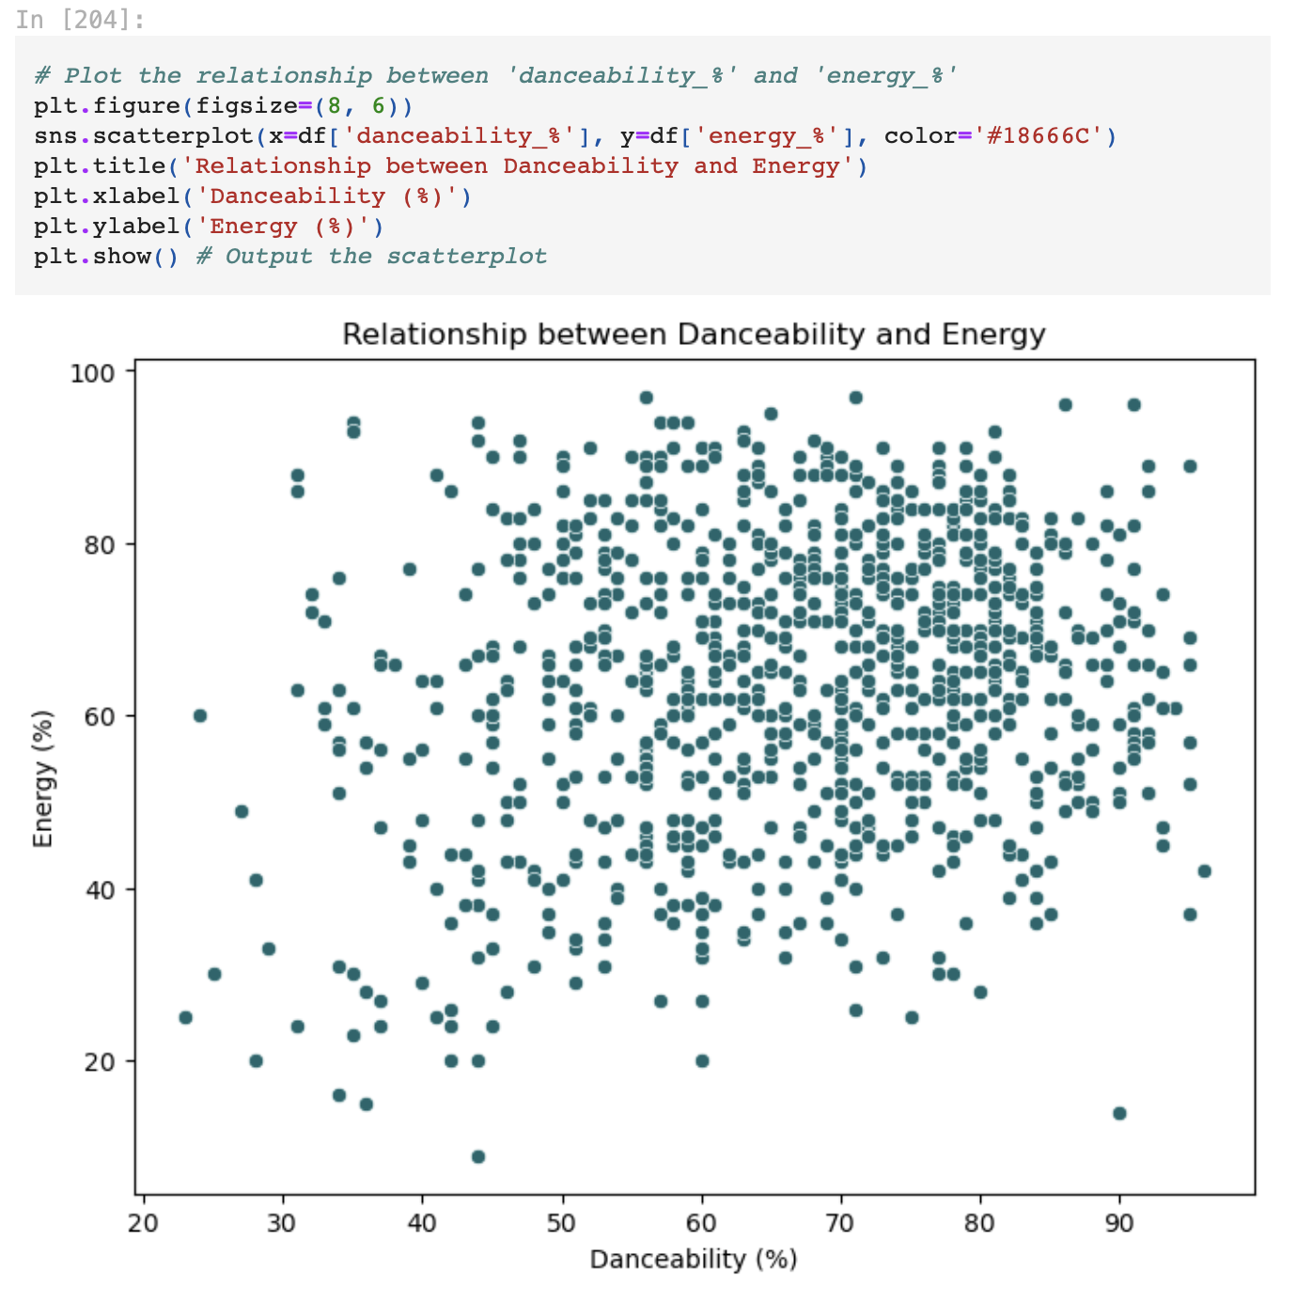
QUESTION 2
For this question, I decided that a scatterplot would be the best way to represent the data.
I asked this question to see if there is correlation between the two columns within the csv.
I concluded that there is not correlation between the two because the points are evenly dispersed throughout the scatterplot.
What is the relationship between the danceability and energy?

Slide 21
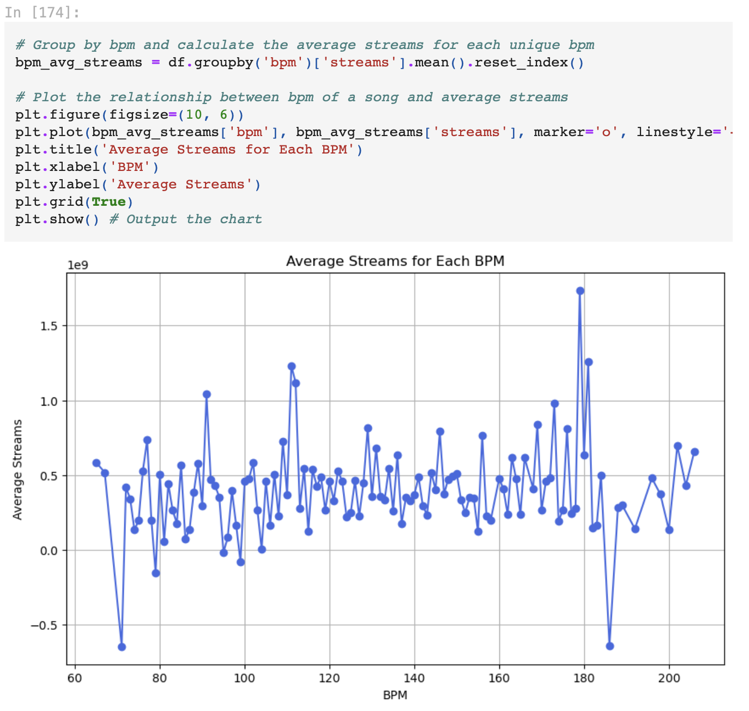
QUESTION 3
This question was picked for songwriters and producers to see what hits do better than and if bpm has any correlation to that.
I concluded that it has some correlation.
If you look at the graph there are 3 major outliers which indicate that those songs do either significantly better or significantly worse than the average top streamed songs.
What is the relationship between bpm and amount of streams?

Slide 22
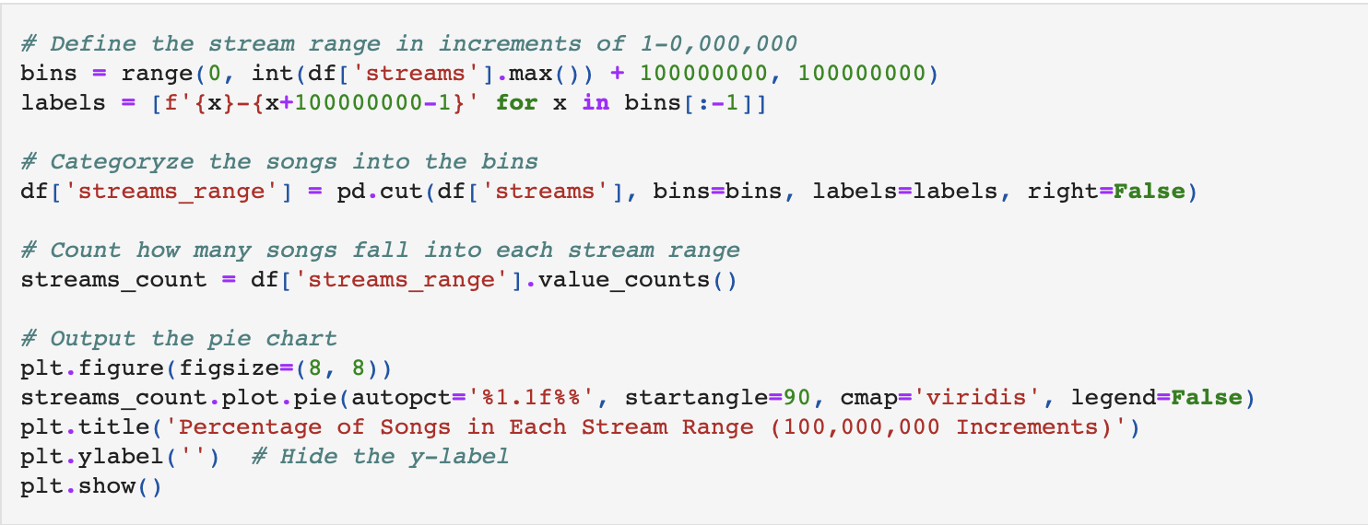
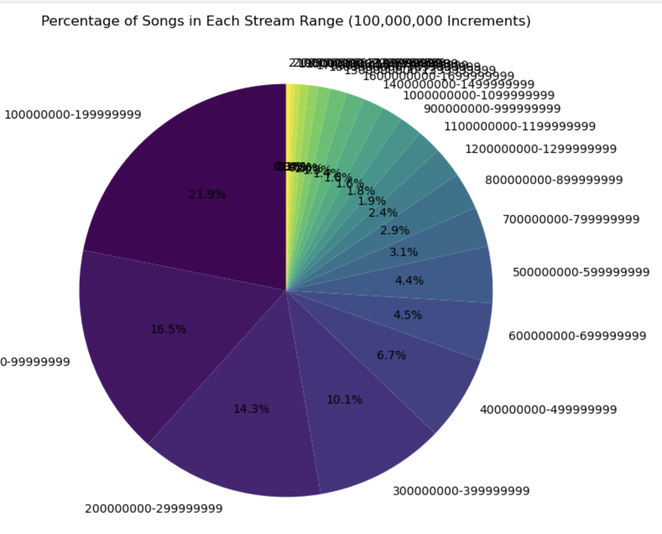
For this last question, I wanted to know how many artists are within each interval of streams. I first started with smaller number such as 100,000 however that number was too small for this data. I eventually worked my way up to 100,000,000 to make the data easier to see.
This would help to figure out where an artist lies in compassion to other artists out there.
QUESTION 4
How many artists are in a certain range of streams?

Slide 23
CLIENT RECOMMENDATIONS
Option One
Look at the streams of the songs that chart well and create a new song with those same attributes if your main goal is to create top-charting songs.
Option Two
Look at the bpm of the most listened to songs. If the songs you make is not as streamed as other bpm’s, then try switching it up.

